Slide 1

IBM Data Science Capstone
Battle of Neighbourhoods

Slide 2
TABLE OF CONTENTS :
INTRODUCTION
DATA SECTION
METHODOLOGY
RESULTS
DISCUSSION
ACKNOWLEDGEMENT
CONCLUSION

Slide 3

INTRODUCTION :
London is one of the most happening places in the UK. Famous for its lavish lifestyle and architecture ,it is one of the most preferred places to reside in.
However , owing to the expensive residencies sided by the current economic and financial crisis , housing prices in London have been on an unprecedent rise causing real estate agencies to back out during the downfall.
Owing to the current scenario , it has indeed become difficult for families wanting to live in independent homes to buy houses of their choice at affordable prices.
Thus the question posed is – Is there affordable housing in London? if so where ?Is the locality good and how is the proximity with respect to facilities such as schools , hospitals and restaurants.

Slide 4
AIM OF THE PROJECT :
The project aims at rendering support to those interested in buying their own homes,to help the make wise and effective decisions under ongoing financial and economic constraints.
Target audience :
Families or individuals wanting to purchase independent homes
Real estate agencies on the lookout for house sales
Business problem :
The question at hand is ‘Are there medium priced houses available for purchase in London? if so , is the construction sound or compromised in lieu with the minimal cost. Are there houses available in good localities with access to amenities such as hospitals , gyms , schools etc’. This project aims to address the above issue.

Slide 5
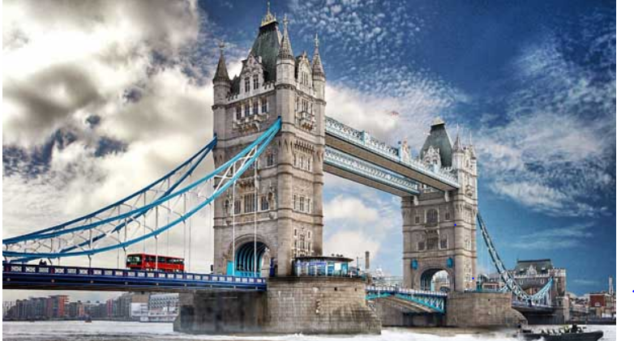
HOUSING AND PRICING PREFERNCES :
The average purchase price for a first time buyer in Greater and Central London is around £509,047 while in South East London it costs around £339,510.However , considering the average pricing of some of the most exemplary localities in London a broad spectrum average of £2,202,125 was determine to set our price range in order to find residencies which fall in the same boundary.
It was also worth taking note of the fact that most people in London , almost 60% prefer residing in flats or condominiums as it was less expensive causing many people to opt out of their preferred choices as shown by the graph on the next slide.

Slide 6
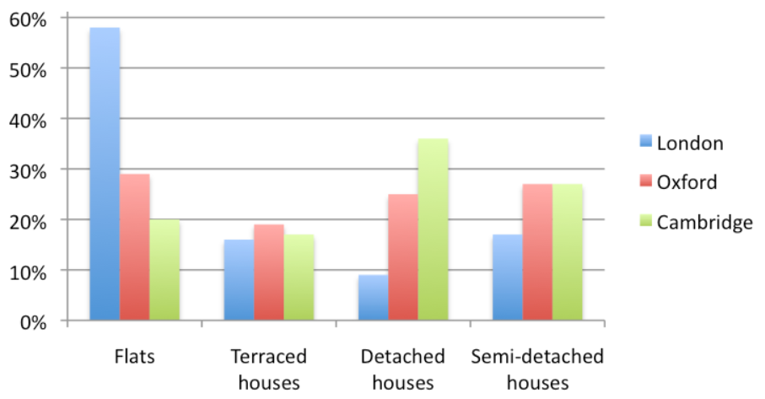
HOUSING PREFERNCES: It can be observed that flats have a higher preference over independent housing.

Slide 7
Data Section: SOURCES
Data on house purchases in the UK were obtained from http://landregistry.data.gov.uk/
Other data sources used for reference were : https://www.testbig.com/ielts-writing-task-i-essays/chart-illustrates-housing-preferences-among-people-who-lived-british
https://www.homesandproperty.co.uk/property-news/buying/the-best-areas-to- start-your-search-for-a-family-house-with-good-links-to-the-city-a116886.html
https://www.zoopla.co.uk/discover/first-time-buyers/london/#4jJFWixLL2Hl0cuD.97

Slide 8
Data acquisition to solve the business problem:
Data was acquired for the following purpose-
House purchase real estate record data of UK from which a list of London streets and their corresponding average purchase prices can be obtained.
Average house costing data in Greater London to get an average price estimate that we are looking for
Geopy to obtain geographic coordinates for visualization
Foursquare API to obtain venues near each of the localities
Folium map to mark and observe the neighbourhoods

Slide 9
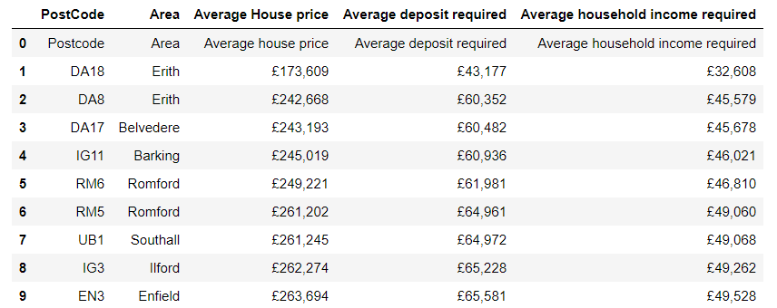
DATA PREPARATION :
Required packages such as pandas , numpy , geopy , folium , foursquare were imported.
Step 1 : Determining average house pricing in great London. Data was webscraped and converted to a data frame. Average price was calculated.
From the above table it can be observed that the average price of some of the well known localities in greater London , one of the most expensive of places, is £2,202,125.The amount was used as a base estimate to determine a suitable pricing range chosen to be between £2,000,000 and £3,000,000.

Slide 10
Data Pre-processing:
Step 2:
The data used for the project was obtained from the UK real estate website. However , in order to analyse , redundant and insignificant data was removed. It involved :
Importing data and renaming /formatting columns
Dropping data / columns that would not be required for further analysis
Rearranging data according to the date or year in order to work with recent information.
Filtering out LONDON specific information by grouping data based on streets that contained the word LONDON.
Determining average House pricing in each street and filtering out those in the range of £2,000,000 and £3,000,000.
Obtaining the geographical coordinates of these localities using geopy.
Obtaining a general visualization of the streets on the map of London using Folium.

Slide 11
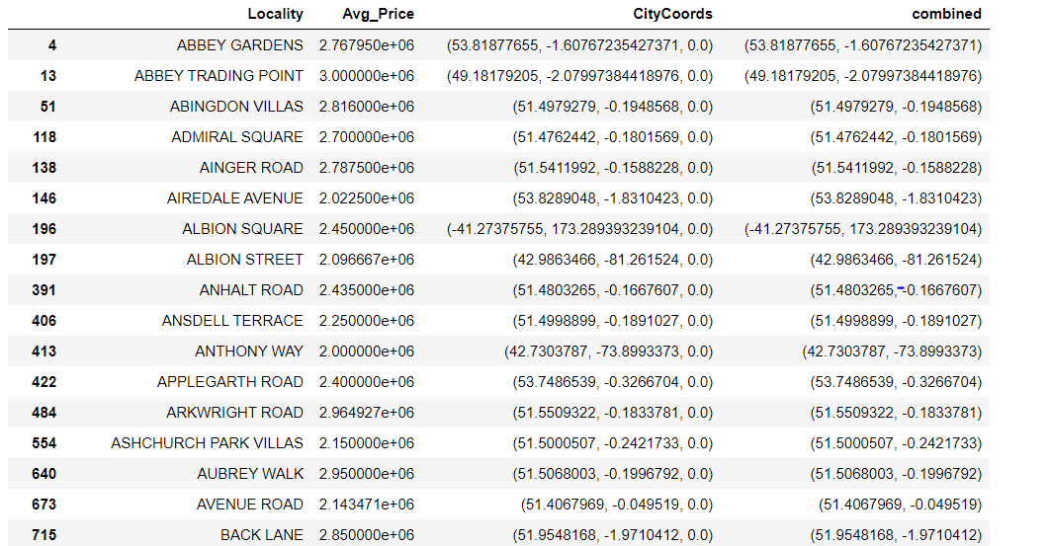
Streets in LONDON with specified average house pricing within range and their respective coordinates.

Slide 12
METHODOLOGY:
After the required data to work was obtained with the use of tools like FOURSQUARE API the most common venues in the vicinity were determined.
The methodology section aimed at :
Obtaining the most common venues in the vicinity of each street in order to find those with relevant amenities using FOURSQUARE.
Explore the neighbourhoods to see if hospitals , schools and gyms and other facilities of importance are within a 2km radius in order to combine pricing with amenities.
Exploratory analysis - Statistical comparison of amenities using box plots
Clustering through a machine learning algorithm called K-means clustering to segment the streets into similar groups that can be prioritized for recommendation.
Plotting the clusters to obtain a visualizations to draw inferences.

Slide 13
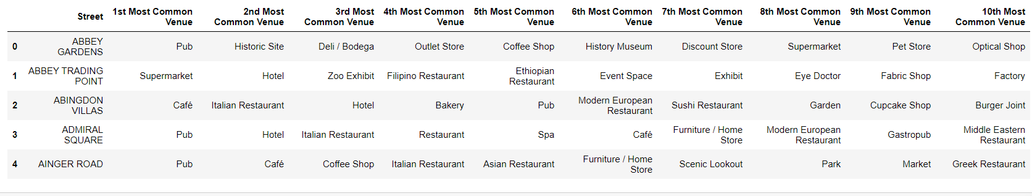
Obtaining frequency of occurrence of all venues for each street and finally consolidating them into the
10 most common venues for each street.

Slide 14
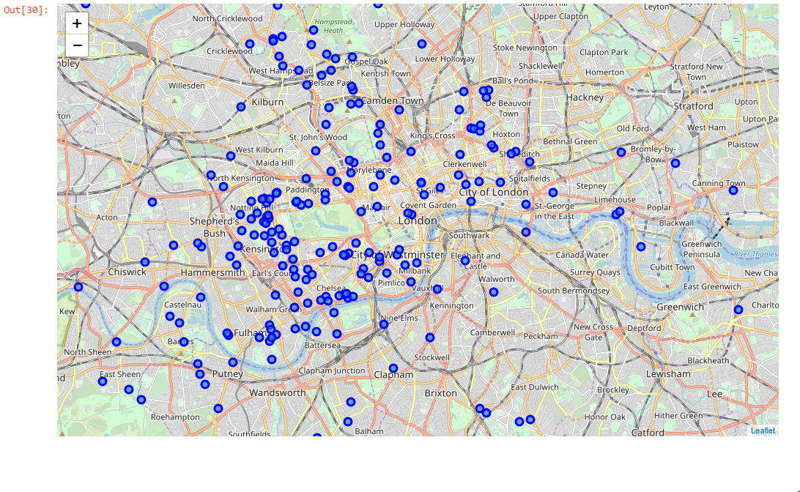
Streets of London : folium

Slide 15
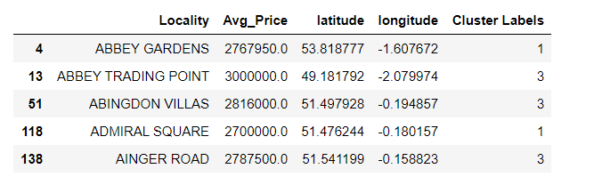
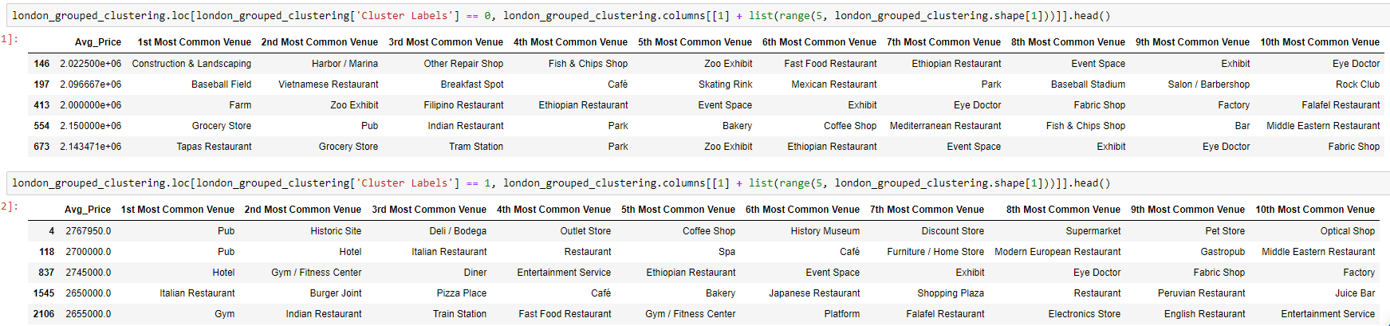
K-MEANS CLUSTERING :
The areas were segmented into five clusters and visualized in order to draw conclusions on which cluster or localities would be preferred over the other.
Adding cluster labels
Cluster 1 and 2

Slide 16
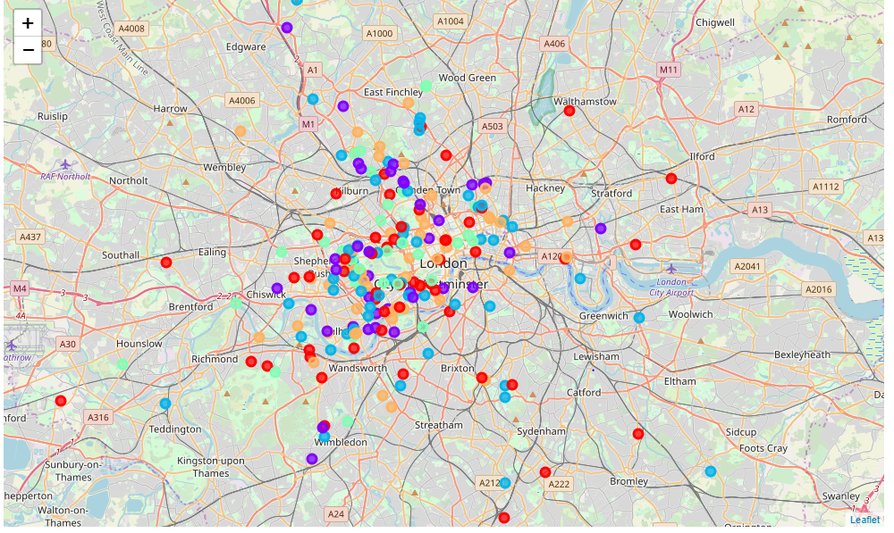
Cluster Visualization :

Slide 17
EXPLORATORY ANALYSIS:
In order to understand the number of occurrences of each category and to use it for comparison , exploratory analysis was conducted using box – plots both normal and transformed.

Slide 18
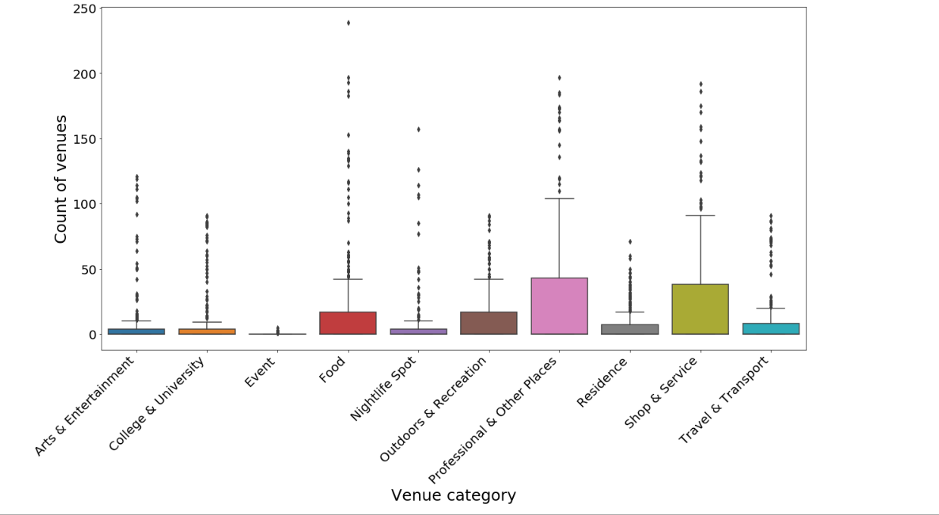
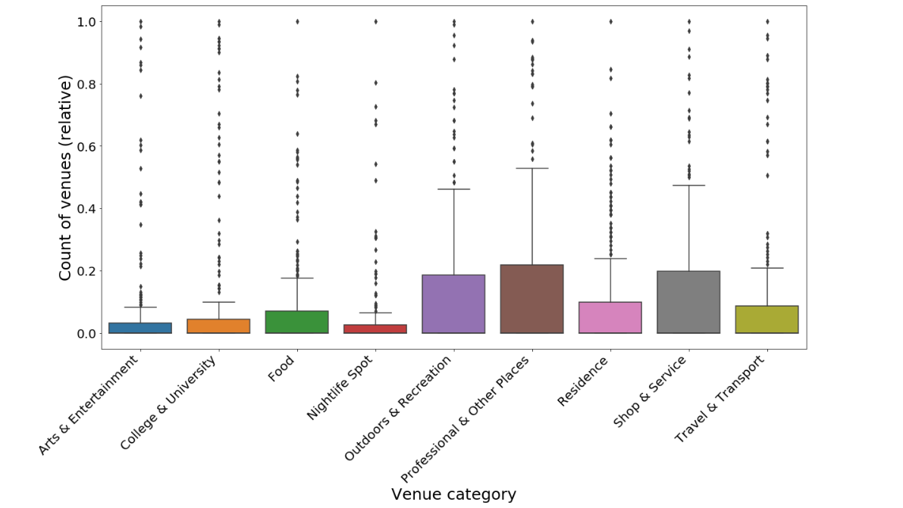
Venue categories based on count of venues
Transformation of venue categories

Slide 19
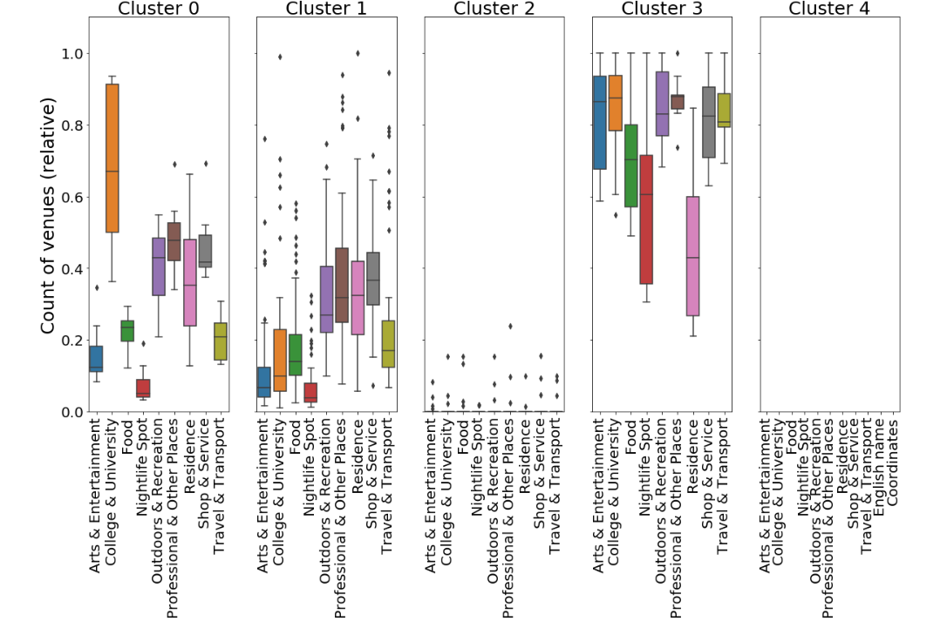
COMPARISON OF CLUSTERS BASED ON NUMBER OF OCCURENCES OF EACH CATEGORY

Slide 20
As it can be clearly observed clusters 0,1 and 3 have most of the amenities. Cluster 0 has a larger number of educational institutions in the vicinity , a residential place with moderately appropriate facilities. Cluster 1 has quite a large number of outliers and moderately placed amenities. Cluster 3 is observed to have higher counts of all categories though their mean and quartile ranges are smaller.
Hence , the localities have been clustered , priced and observed and the following results have been drawn.

Slide 21
Results :
As per the scope of this project the following results were observed :
Average house considered for the project is between £2,000,000 - £3,000,000 which was determined based on mean price of £2,202,125
From the pricing statistics , it can be observed that 50% of the localities have a mean price of 2,400,000 pounds and a major 75% make up for a price value of 2,650,000 pounds which is a good price representative range.
The streets of London were segmented into five clusters.
Cluster 0 – approximate price range (2,000,000-2,150,000)
Cluster 1 – approximate price range (2,650,000-2,800,000)
Cluster 2 – approximate price range (2,150,000-2,350,000)
Cluster 3 – approximate price range (2,810,000-3,000,000)
Cluster 4 – approximate price range (2,350,000-2,500,000)
All clusters had ample restaurants and recreational facilities in the vicinity.
The clusters were viewed on the map.
With respect to proximity of prominent amenities in each location , from a general perspective it can be observed that cluster 0 ,cluster 1 and cluster 3 have the most prominent number of venue categories.
cluster 0 has the least pricing , more educational institutions , preferable transportation and professional locations in the vicinity. cluster 1 has a large number of outliers with a comparatively small range of facilities. However , it is still a preferred location for residence and has a comparatively higher pricing range. cluster 3 has the highest pricing range in the average scale , however it is still affordable and has enumerable benefits and facilities with the highest occurrence of amenities - educational institutions, food , nightlife, transportation and highest number of residencies as well.
The clusters were compared in order to draw inferences on the best cluster using exploratory analysis - box plots

Slide 22
DISCUSSION:
Despite the economic crisis , from the data acquired , it can be observed that there is good affordable housing within a range of about £2,000,000 - £3,000,000 in London with almost 414 streets predominantly falling in the range. In order to increase the stake of preferences the venues in the vicinity of each street were viewed and it can be observed that there are plenty of restaurants and eateries in the vicinity of each street. When it comes to schools, local stores , work place, transportation etc , which are extremely important to family residents it can be observed that cluster 3 has the most number and occurrence of various amenities followed by cluster 0.In terms of pricing however cluster 0 is cheaper than cluster 3. This helps with deriving conclusions on the order of precedence of clusters as follows: In terms of pricing ,order of precedence would be :
cluster 0
cluster 1
cluster 3
In terms of pricing and amenities combined :
cluster 3
cluster 0
cluster 1
It depends on the preference of the customer , However places like Croydon, Colindale, Bromley, Hornchurch, Woolwich, Leytonstone, Brentford and Crystal Palace belonging to these above mentioned clusters can definitely be recommended.

Slide 23
CONCLUSION:
The scope of the project was to address the question of preferable housing suggestions to real estate agencies and real estate clientele interested in purchasing their own independent homes. In lieu with the expectation , localities with affordable residences were clustered , visualized and the ones with best amenities were deduced in order to render valuable suggestions to the target audience. Through the course of the project it was observed that comparatively cheaper and good quality homes are available in London and just that one needs to be on the lookout for it. The most dominant cluster was cluster 3 followed by cluster 0 while taking both amenities and pricing into consideration and some of the most predominant localities were found to be Croydon, Colindale, Bromley, Hornchurch, Woolwich, Leytonstone, Brentford and Crystal Palace. Thus , I believe the project has addressed 60% of the housing issue. However there is a broader scope for further in depth analysis to suggest housing not just based on vicinity and pricing but also on the type of housing ,transportation, design and alternatives to amazing and yet affordable architectural constructs such as rooftop housing , bridged housing etc with more advanced exploratory analysis and machine learning techniques..

Slide 24

THANK YOU

